Slide 1

ARTIFICIAL INTELLIGENCE
CSD-311
CONNECT - N
END SEM PROJECT - GROUP 13

Slide 2
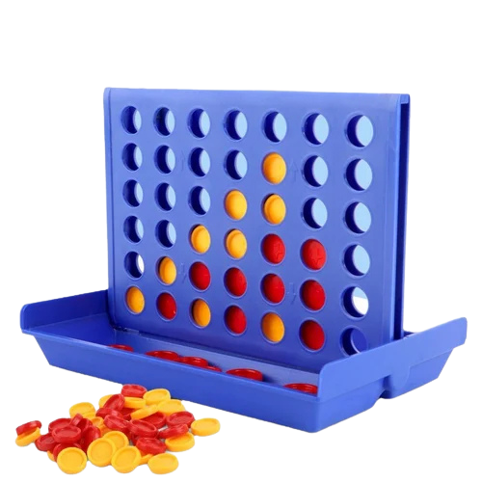
The Connect - N problem
About the Project
We are presenting the development of a Connect-N game where two players compete to form a sequence of 'N' pieces in a grid. The game supports two modes: Player vs Player and Player vs Computer. The AI opponent, in the Player vs Computer mode, is powered by the Minimax algorithm with Alpha-Beta Pruning for efficient decision-making. The primary goal is to provide a robust AI that can adapt to varying difficulty levels: Easy, Medium, and Hard. The evaluation of AI performance and gameplay experience is included, with recommendations for future improvements to enhance the AI's strategic decision-making.

Slide 3
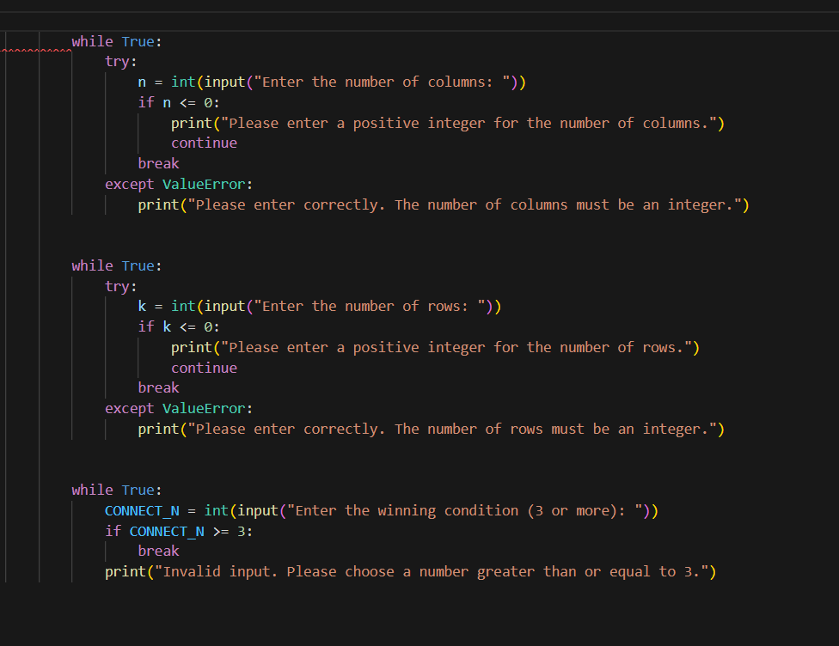
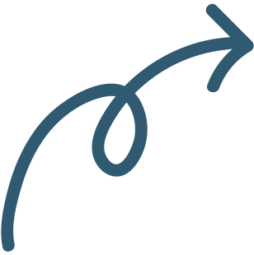
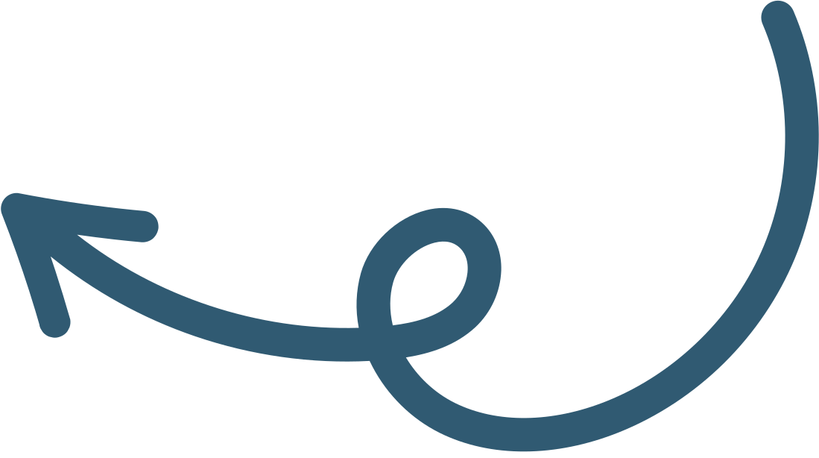
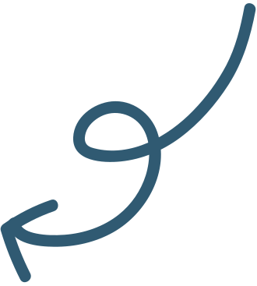
Game Settings
(User Input Section):
Setting the Number of Columns (n)
01
Purpose: This block collects the number of columns for the game board.
Setting the Number of Rows (k)
02
Purpose: This block collects the number of rows for the game board.
Setting the Winning Condition (CONNECT_N)
03
Purpose: This block sets the winning condition—the number of connected pieces required to win the game.

Slide 4
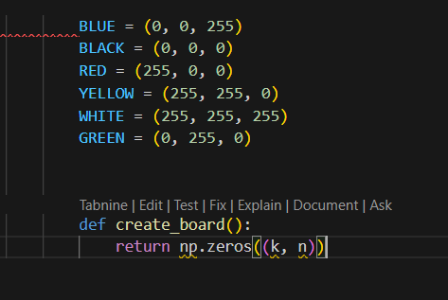
Game Board Initialization:
Setting up the GUI board
01
Defines color constants in RGB format for use in the game (background, piece colors, and winning highlight).
2D Numpy Board
02
Initializes the game board as a 2D NumPy array filled with zeros, where the rows are k and columns are n. This represents an empty grid with no pieces placed yet.

Slide 5
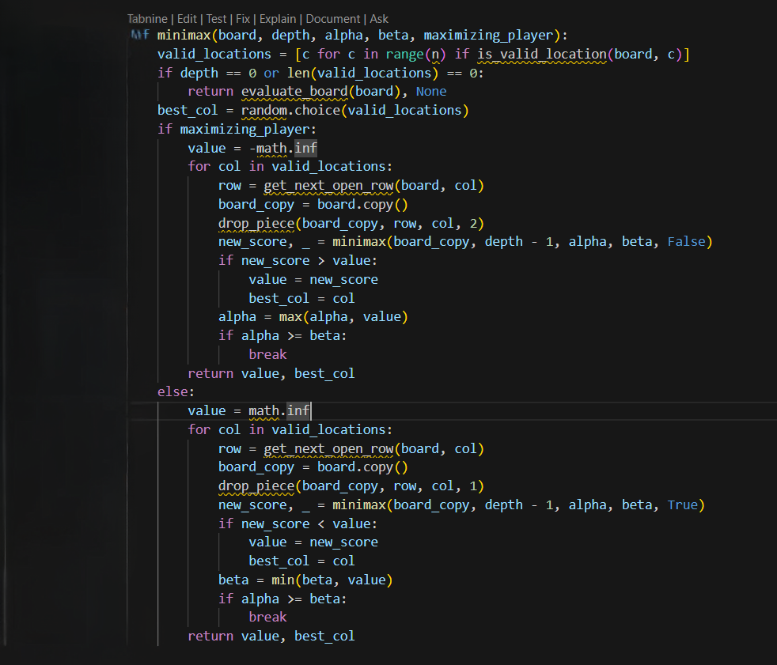
MinMax Algorithm & Code
Exploring All Possible Valid Moves
01
Finds the next available row in a column, simulates dropping a piece on a copied board, and recursively calls minimax with reduced depth, switching to the minimizing player to evaluate outcomes.
Maximizing Player & Alpha-beta pruning
02
Updates the best score and column if a better score is found. Implements alpha-beta pruning to limit the search space: alpha (maximizer's best) and beta (minimizer's best). Stops exploring a branch if alpha ≥ beta to optimize performance.
Minimizing Player's Turn
03
Simulates opponent moves to minimize the AI's score, updating the best score and column for the minimizing player. Incorporates alpha-beta pruning to ensure the AI selects moves that reduce the opponent's winning chances.

Slide 6

How the MinMax Algorithm Works
Recursive Simulation:
01
The minimax function simulates all possible moves to a certain depth.
At each step, it alternates between:
Maximizing Player (AI): Chooses moves to maximize the score.
Minimizing Player (Opponent): Chooses moves to minimize the score.
Board Evaluation:
02
When the recursion reaches the base case (depth == 0 or board full), it evaluates the board using evaluate_board.
Backtracking:
03
The scores from lower levels of the recursion are propagated back to the root.
The best move is chosen based on these scores.
Alpha-Beta Pruning:
04
Prunes unnecessary branches of the search tree to save computational time.

Slide 7
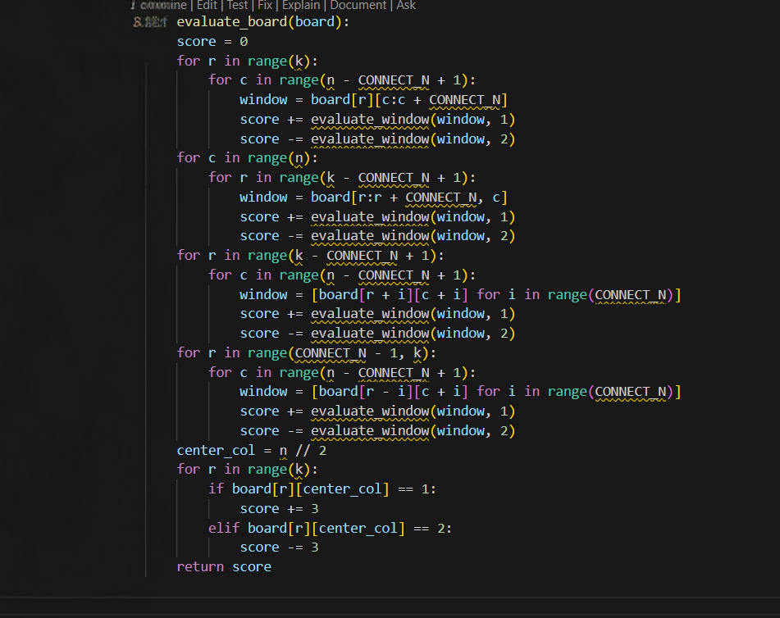
Evaluate Board Function
Horizontal & Vertical Evaluation
01
Iterates through each row, checking horizontal groups of size CONNECT_N. Evaluates each group for both players using evaluate_window, adding player 1's score and subtracting player 2's. Identifies advantageous horizontal & Vertical patterns.
Positive & Negative Diagonal Evaluation
02
Iterates through valid starting positions for diagonal groups of size CONNECT_N. Constructs and evaluates windows sloping positively (down-right) and negatively (up-right) for both players to identify advantageous patterns.
Center Column Bias
03
Adds a bonus score for pieces in the center column.
Pieces in the center column are more likely to contribute to horizontal, vertical, and diagonal connections.
Purpose: Encourages moves that maximize opportunities for connections.

Slide 8

How the Evaluate Board Function Works
Pattern Evaluation:
01
The board is evaluated in all four directions (horizontal, vertical, and two diagonal directions)
Each group of CONNECT_N (a "window") is checked for patterns using the helper function evaluate_window
Positive contributions indicate an advantage for player 1, while negative contributions indicate an advantage for player 2
Bias Towards the Center:
02
The center column is prioritized to maximize future connection opportunities
Final Score:
03
A positive score favors player 1, while a negative score favors player 2

Slide 9
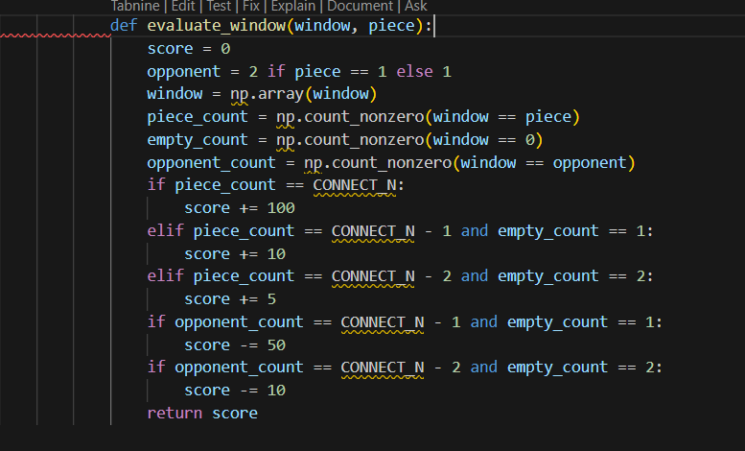
Evaluate Window Function
Count Components in the Window
01
Converts the window to a NumPy array to count the player's pieces, empty cells, and opponent's pieces. Evaluates the window's strategic importance.
Favorable Patterns for the Player
02
Assigns scores to the window based on favorability: (CONNECT_N) 100 for a win, (CONNECT_N - 1) 10 for a near win, and (CONNECT_N - 2) 5 for a potential connection. Guides the AI to prioritize advantageous or promising moves.
Blocking the Opponent
03
Penalizes the score if the opponent has a near win (-50 points) or a potential connection (-10 points). Encourages the AI to block opponent threats, prioritizing imminent dangers.

Slide 10
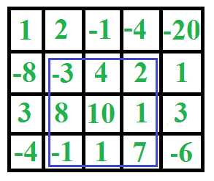
How the Evaluate Window Function Works
Evaluation:
Counts the AI's pieces, opponent's pieces, and empty cells in the window.
Gives positive scores for good setups for the player (e.g., near-complete connections) and negative scores for setups favoring the opponent, especially close threats.
Purpose in the AI
The evaluate_window function is the core of the evaluate_board scoring system. Here's how it works:
It counts the AI's pieces, the user's pieces, and empty spaces in a window.
Positive scores are given for good setups for the AI, like nearly complete connections.
Negative scores are given for setups that help the user, especially if they're close to winning.
This scoring helps the AI, along with the minimax algorithm, choose moves that increase its chances of winning while blocking the opponent's opportunities.

Slide 11
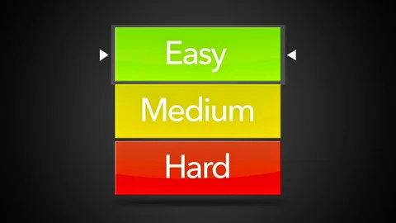
Nuances of Implementation
How we went about the difficulty levels
Difficulty | Decision Process
Easy | Randomly selects a move.
Medium | Minimax with alpha-beta pruning(depth -3)
Hard | Minimax with alpha-beta pruning(depth -7)

Slide 12
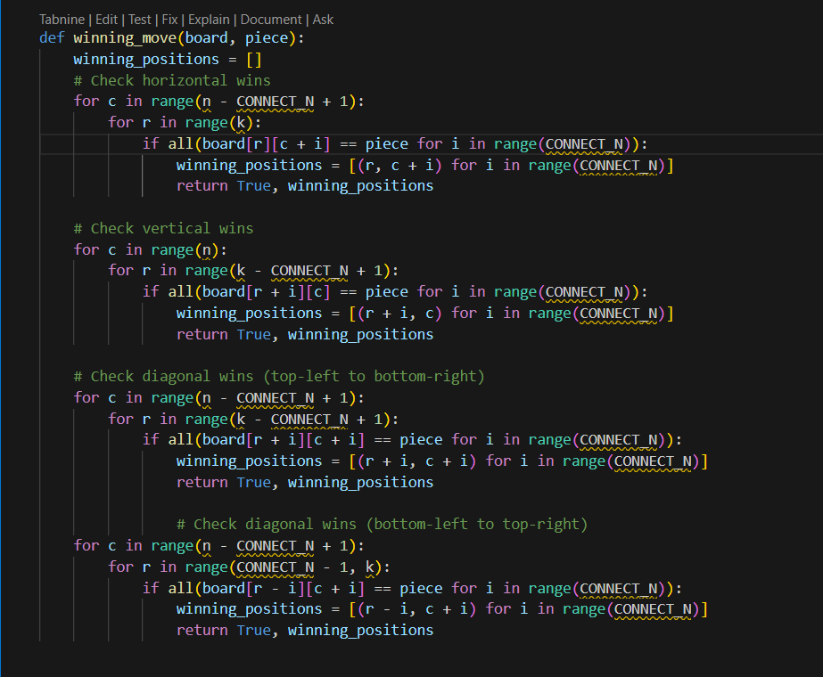
Winning Move Detection:
This function checks if there is a winning move for the given player (piece)
If no winning condition is met, returns False and an empty list.

Slide 13
Limitations , Suggestions & Improvements.
Adaptive AI
Make the computer's difficulty dynamically adjust based on player performance.
Instead of fixed difficulty levels, provide AI Specific Instructions (e.g., offensive, defensive, or random, etc)
Tutorial mode
Implement the AI for the user which helps by providing hints (can also implement visual help for the same)

Slide 14
THANK YOU

